Slide 1

Introduction to Databases
and Data Storage Technologies
April 7, 2021
Dr. Carl Stahmer
Executive Director, UC Davis DataLab
Notes:
BALA

Slide 2
datalab@ucdavis.edu

Slide 3
Learning Objectives
Compare and contrast different data storage platforms;
Explain the difference between SQL and noSQL databases;
Explain the components of an Entity Relationship Diagram (ERD)
Define Relational Keys;
Identify appropriate data storage solutions based on the structure of a research dataset.
Notes:
CARL
6 startup projects: Epidemiology - Beatrice Lopez, VetSchool Liver Cancer, Cardiology, Alzheimer's, Geomorphology - Magali (3D viz) Eugenics - Emily Merchant Political Experts - Stephanie Mudge (Sociology)
Ongoing internal research projects: Quintessence, COVID Docs
Collaborative funded projects: WateReview - Sam Sandoval Solis, LAWR (S America) Science in Gov’t Policy - Tyler Scott (ESP)** Micromobility - Transportation Institute EBBA, Getty, Hack4CA - Lindsay Poirier Secure Computational Pipelines, Cardiology, Pediatric Diabetes

Slide 4
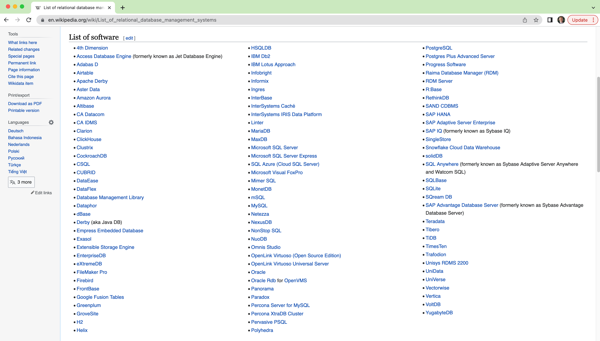
Range of Options for Managing Data
Several data storage structures from which to choose, each of which has implications for how you will interact with data in the future as well as security, redundancy, and other data management concerns;
Range of software options for working with your data once you’ve decided on an appropriate data storage structure.
Wikipedia list of relational database management software.
Notes:
PAMELA

Slide 5
Principals of Data Storage
The following principals should serve as the foundation for your decision of data storage method and software:
All Data Has a Structure Inherent to Itself;
Different Research Questions are Facilitated by Different Data Structures;
All Data Stores Impose an Underlying Data Structure;
The "Best" Data Storage Technology for any Research Endevor is the One that Best Synergizes the Inherent Structure of the Data Itself with the Range of Research Questions Being aked of the Data.
Notes:
So i the learning objectives I talked a ton about metadata.
So metadata is defined as
[READ]
When we talk about creating documentation for a project, or describing your workflow, we're talking about metadata.

Slide 6

Vocabulary: Data
“Quantities, characters, or symbols on which operations are performed by a computer, considered collectively. Also (in non-technical contexts): information in digital form.”
Oxford English Dictionary
Source: DARPA, Public domain, via Wikimedia Commons

Slide 7
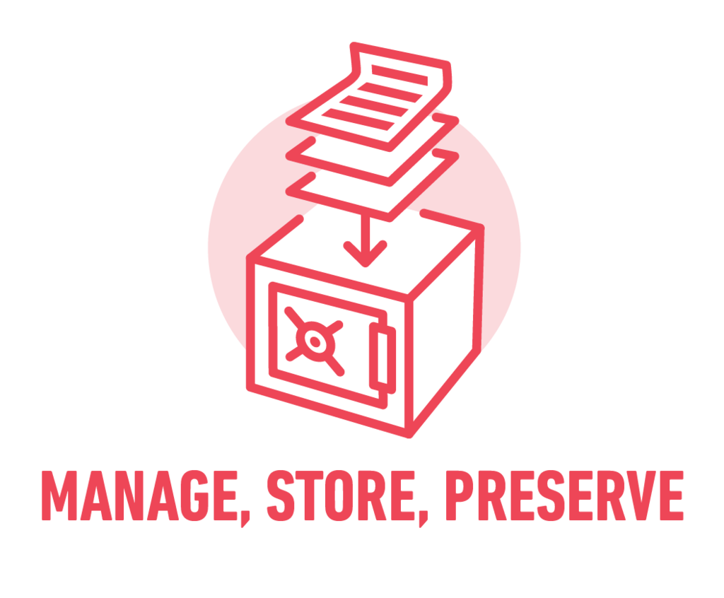
Vocabulary: Data Store
A generic term describing any mechanism for digitally storing and managing data. “A repository for persistently storing and managing collections of data which include not just repositories like databases, but also simpler store types such as simple files, emails etc.”
Gaelen Pinnock, CC BY-SA 4.0, via Wikimedia Commons
Wikipedia

Slide 8
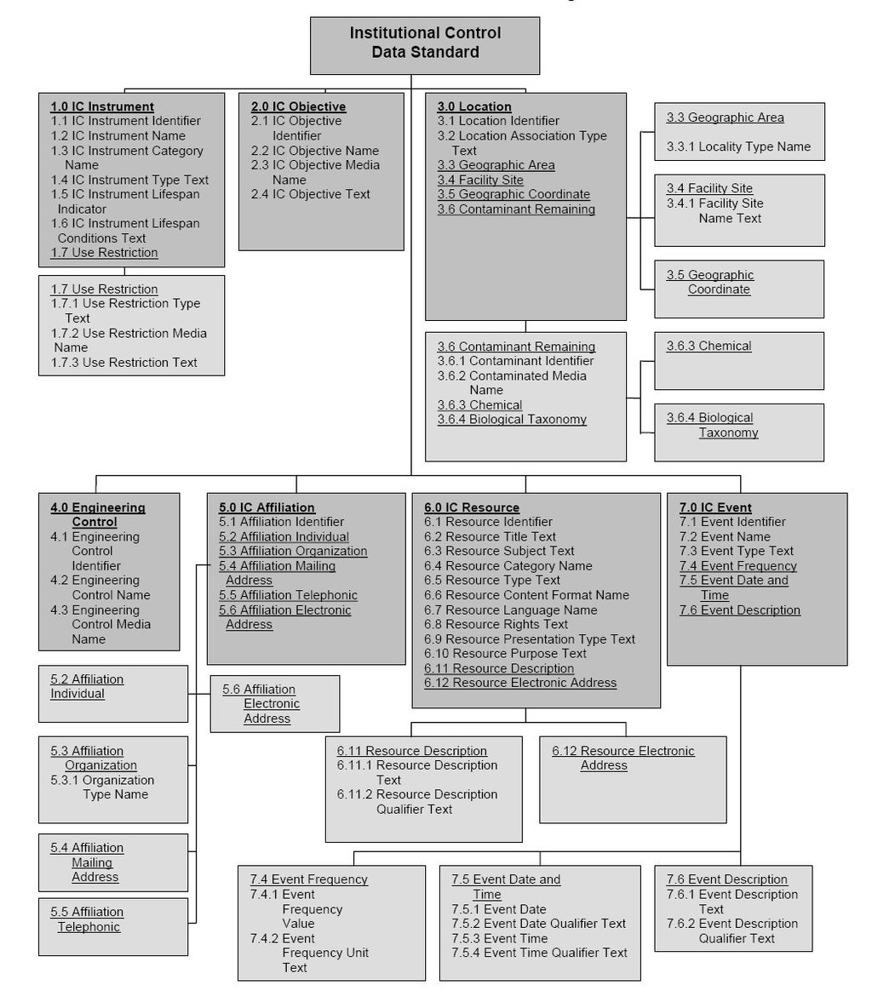
Vocabulary: Data Structure
“In computer science, a data structure is a data organization, management, and storage format that enables efficient access and modification. More precisely, a data structure is a collection of data values, the relationships among them, and the functions or operations that can be applied to the data.”
Wikipedia
Environmental Data Standards Council (EDSC)., Public domain, via Wikimedia Commons

Slide 9
Vocabulary: Data Type
“A data type or simply type is an attribute of data which tells the compiler or interpreter [or data store query system] how the programmer intends to use the data. Most programming languages support basic data types of integer numbers (of varying sizes), floating-point numbers (which approximate real numbers), characters and Booleans. A data type constrains the values that an expression, such as a variable or a function, might take. This data type defines the operations that can be done on the data, the meaning of the data, and the way values of that type can be stored.”
Wikipedia

Slide 10
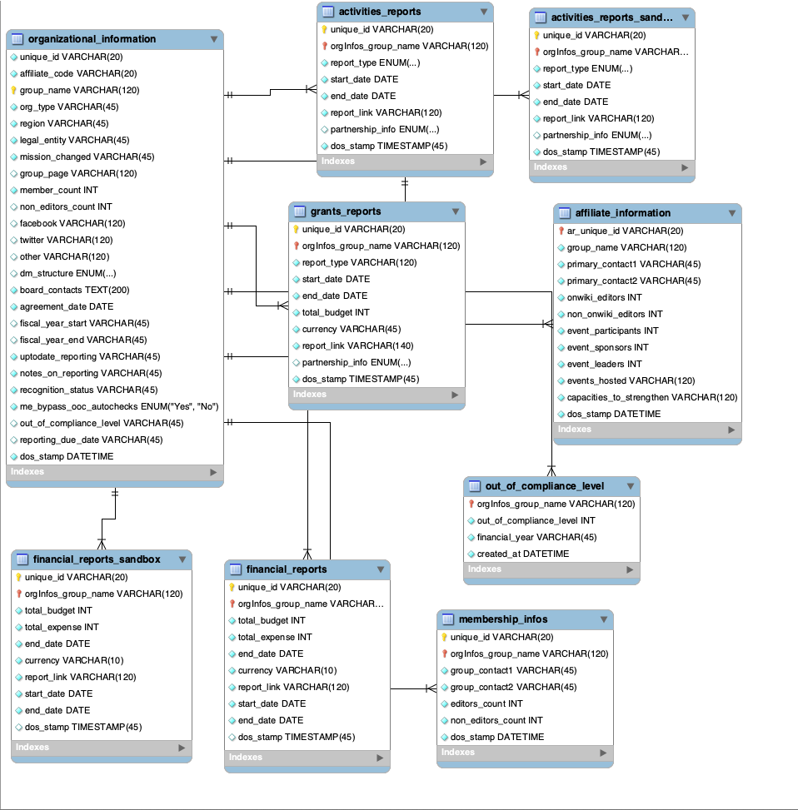
Vocabulary: Database
A database is an organized collection of data stored and accessed electronically;
Small databases can be stored on a file system, while large databases are hosted on computer clusters or cloud storage;
The design of databases spans formal techniques and practical considerations including data modeling, efficient data representation and storage, query languages, security and privacy of sensitive data, and distributed computing issues including supporting concurrent access and fault tolerance;
Interacting with a database requires specialized software knows as a Database Management System (DBMS);
People frequently use the word “database” when what they mean is Data Store: Don’t do this!!!
DAlangi (WMF), CC BY-SA 4.0, via Wikimedia Commons

Slide 11
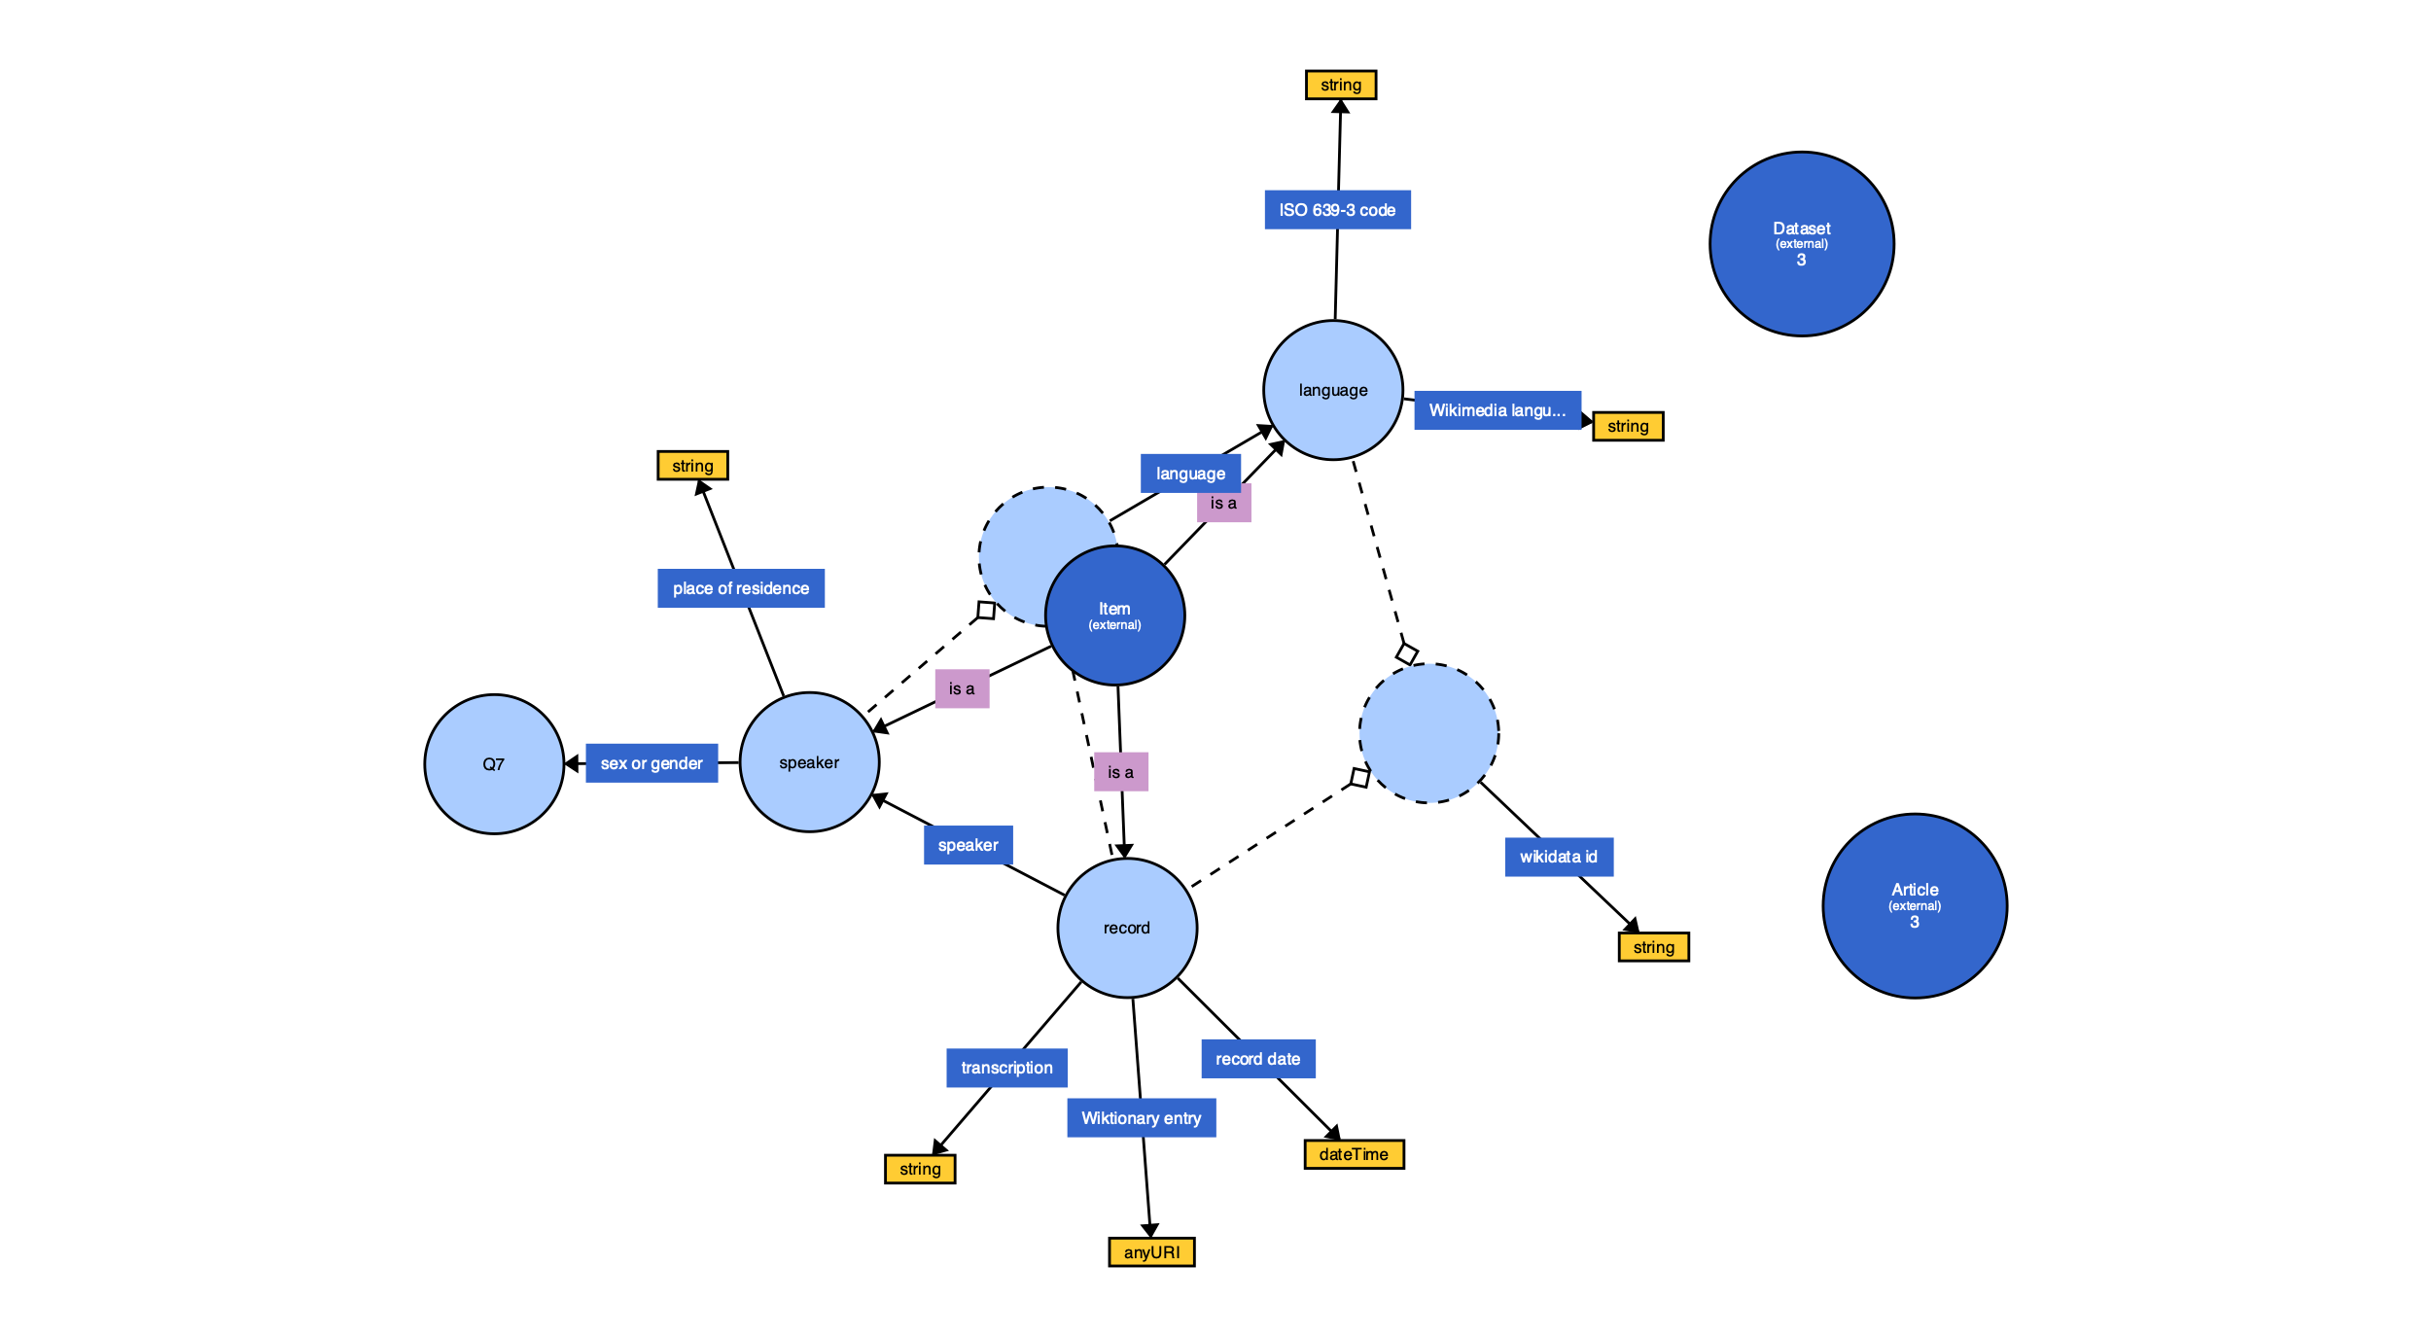
Structures Inherent to Data Collections
Data is information that represents entities in real world or IRL;
Nothing exists IRL without context. This includes physical, discursive, and even abstract and theoretical entities;
The context in which entities exist in IRL define an a priori structure for our data.
Felix M. (Elfix), CC0, via Wikimedia Commons

Slide 12
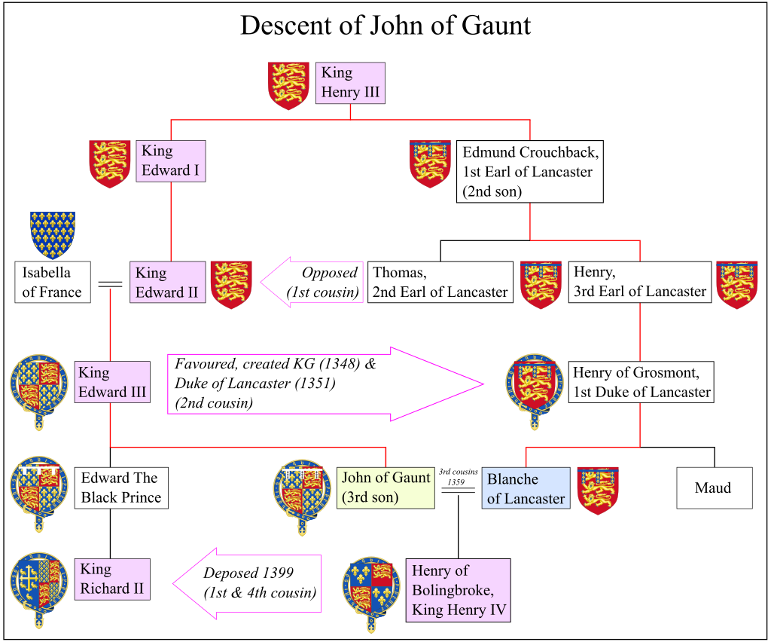
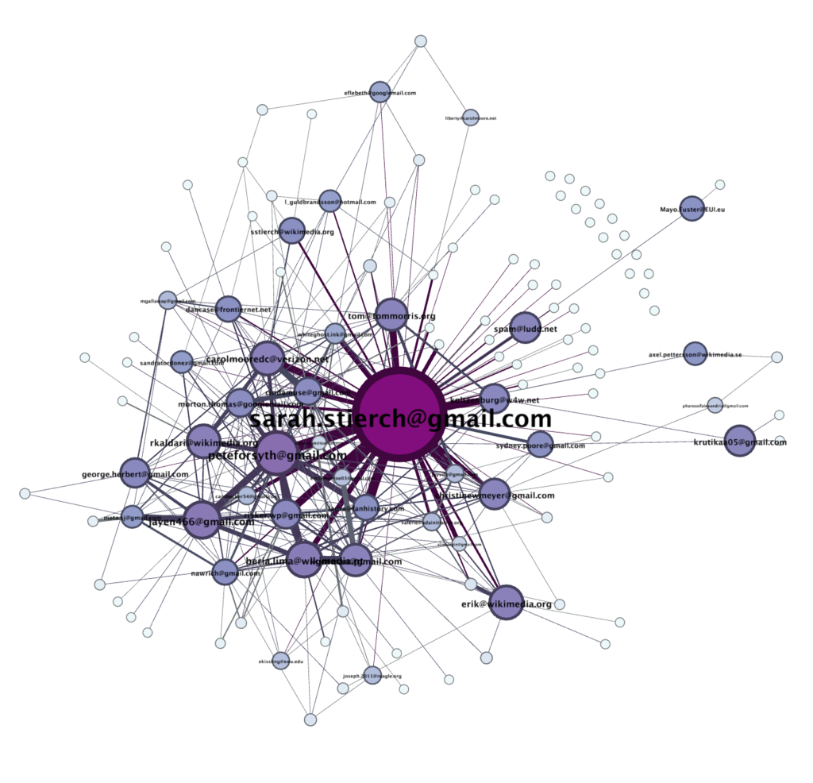
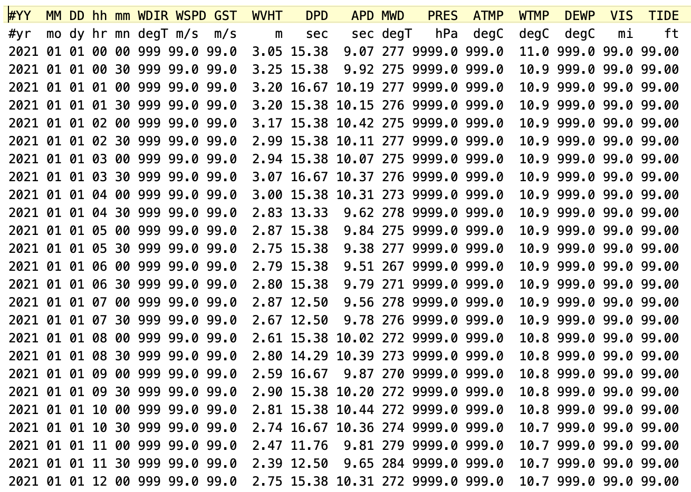
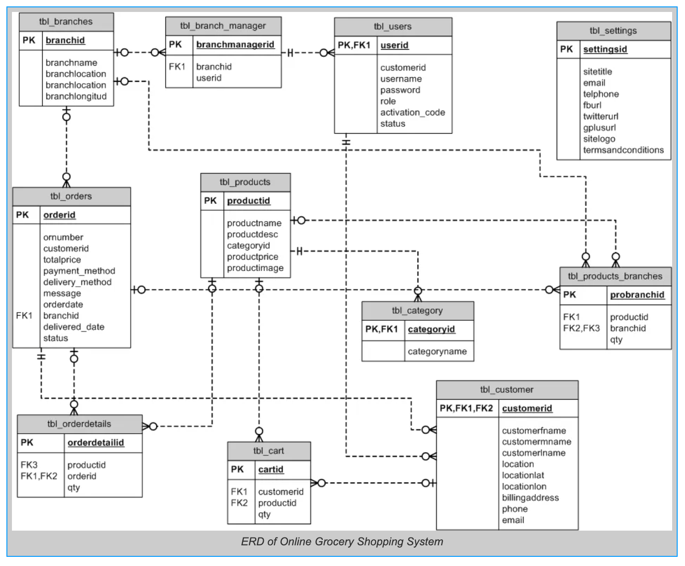
Four Primary Data Structures
Tabular/Columnar
Tree
Graph
Categorical/Relational

Slide 13
Tabular/Columnar Data
Multiple observations of the same type;
No categorical values or interrelationship between observations;
The table itself is the only organizing principal.

Slide 14
Tree Data
Data captures relationship between entities;
Relationships are hierarchical;
Relationships are directional;
Hierarchy is defined by levels of embedding.

Slide 15
Graph Data
Data captures relationship between entities;
Relationships are non-hierarchical;
Relationships are directional;
Relationships are defined by distance rather than levels.

Slide 16
Categorical / Relational Data
Category membership is a primary organizing principal of the data;
Individual entities in the data are acted upon by other entities in the data in categorical ways;
Individual entities can have multiple class memberships of varied number;
Relational data structures tend to represent complex process rather than individual entities.

Slide 17
”How is political affiliation and behavior affected by social factors such as class, profession, and familial associations?”
Data Structures Inherent in Research Question
”Was Shakespeare really the author of the texts we attribute to him?”
Different research questions are facilitated by different data structures
”How does ocean acidification affect the growth of ocean micro-organisms?
”How does fake news propagate through the social network?”
Notes:
BALA

Slide 18
Assessment Guidelines
Answers to the following questions will help you to determine the best, native data structure for your research question?
Is my research question primarily driven by class association(s)?
Is my research question primarily concerned with defined relationships between entities?
Is my research question primarily concerned with statistical analysis of continuous values of variables shared across observations?
Is my research question hierarchical in nature?

Slide 19


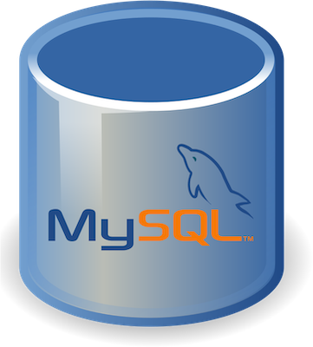


Data Structures Imposed by Data Technologies
The software you use to collect, manage, and interact with your data will often impose its own data structure on your data;
Understanding what these are is key to harmonizing your data with your research question
Notes:
BALA

Slide 20
High Altitude Features by Type
Spread-sheet
Killer App - sortable, summable, operational
RDBMS
Indexable, structured, enforceable
NoSQL
Flexible data structure, extensible, some indexable
Transactional to millions of transactions per day
Limited data storage capability
Transactional to a few thousand transactions per day
Poor Data Management
Exceptional Data Management
Data Management Eternal to System

Slide 21
Tabular Data Store Characteristics
PROS:
Fast
Easy
Ubiquitous
GUI
CONS
Scaling
Normalization
Integrity
Most popular include Microsoft Excel, Google Sheets, OpenRefine, Open Science Framework

Slide 22
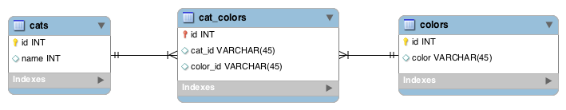
RDBMS Data Store Characteristics
PROS:
Supports strict ACID (Atomic, Consistent, Isolated, Durable) transactions
Supports Joins
Relationships with defined constraints
Built-in data integrity through normalization and data typing
Limitless Indexing
Strong query language
Large ecosystem
CONS
Does not scale horizontally (concurrency and data size), only vertically, unless sharding
Data is normalized, resulting in many joins and loss of speed
Difficulty working with hierarchical and graph data
Significant system administration effort
Data not human readable
Schema on write (pre-defined data model)
ID | NAME | BREED | COLOR | EAR | FUR
1 | Fluffy | Sphynx | Tabby | Large | None
2 | Major Tom | Scottish | Grey | Floppy | Medium
3 | Josie | Sphynx | Tabby | Large | Fuzz
Most popular are MySQL, PostgreSQL, Microsoft SQL Server, Oracle Database, IBM DB2, Microsoft Access

Slide 23
Tree and Graph Data Store Characteristics
PROS:
Works with semi-structured data (JSON, XML)
Horizontal Scaling
High consistency and Volume
Random reads and writes
Massive data stores
Schema free / schema on read
Supports documents with different fields
High availability
Simplicity of design (no impedance mismatch)
Finer control over availability
Speed (do to lack of joins)
CONS
BASE (Basic Availability, Soft-State, Eventual) as opposed to ACID
Limited support for joins
Data is de-normalized
No built-in support for integrity, validation must be performed programmatically during insert
No relationship enforcement
Limited Indexing
Weak SQL
Limited transaction support
Slow, mass indexing
Popular platforms include MongoDB, DocumentDB, Cassandra, Coachbase, HBase, Redis, Neo4j, Solr/Lucene, ArangoDB

Slide 24

Choosing the Right Option
Often involves competing inherent needs;
Cost consideration;
Workflow consideration.
Notes:
BALA

Slide 25
CAP Theorem
Impossible for any system to deliver all three of the following at the same time:
CONSISTENCY: Nobody ever gets broken or partial data
AVAILABILITY: Data will be available at all times with no lockouts.
PARTITIONING: If one part of the database is changed, other parts remain unaffected
CONSISTENCY
RESPONSE TIME

Slide 26
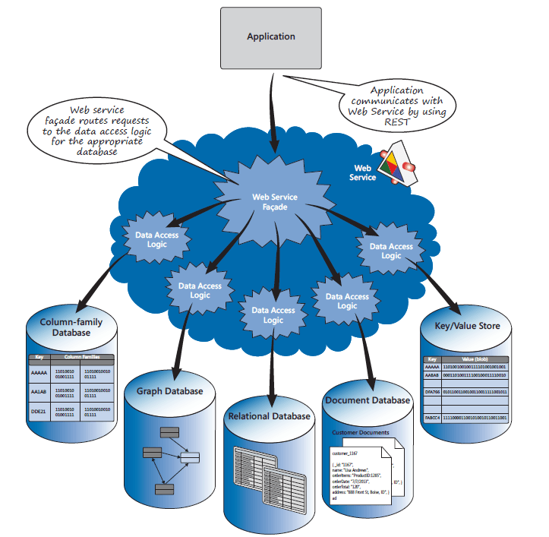
Polygot Persistance
Using multiple data storage technologies for varying data storage needs across a research pipeline or within smaller components of a research pipeline.
Different systems may better reflect inherent data structures;
Data storage and management needs may impose non-optimal data structures;
Size of data may require partitioning. Different partitions can live in different systems;
Number and speed of query may necessitate RDBMS for certain portions of enterprise but not for others

Slide 27
Thank You
Dr. Carl Stahmer
Executive Director, UC Davis DataLab
https://datalab.ucdavis.edu
Notes:
BALA

